Slide 1
Environment Interface Standard (EIS)
COMP41400: Multi-Agent Systems
Lecturer: Rem Collier
Email: rem.collier@ucd.ie

Slide 2
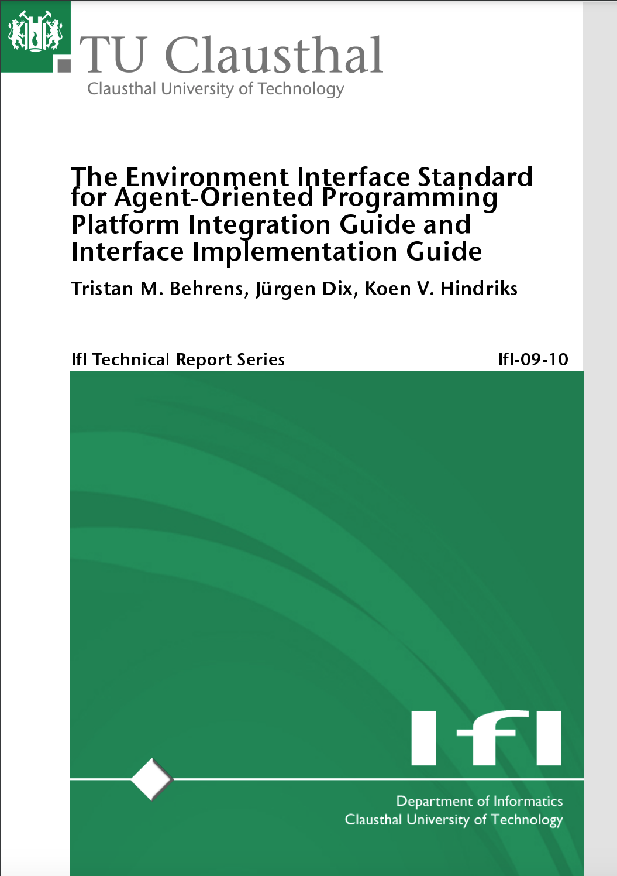
Introduction
Known as EIS (pronounced “ice”).
Collaboration between TU Clausthal & GOAL Research Group (Uni. Amsterdam)
Attempt to standardise the implementation of environments.
Write once use anywhere philosophy (Jar files)
Defines a standard interface that languages must adhere to.
Defines a standard interface that environment developers must adhere to.
Open Source Framework:
https://github.com/eishub/eis
https://d-nb.info/1037809882/34

Slide 3
Basic Idea
Agent Platform

Slide 4
Basic Idea
Agent Platform
launch
Environment Interface

Slide 5
Basic Idea
Agent Platform
launch
Environment Interface
creates
Environment

Slide 6
Basic Idea
Agent Platform
launch
Environment Interface
creates
tower.jar
Environment
Entity 2
Entity 3
Entity 5
Entity 1
Entity 4

Slide 7
Basic Idea
Agent Platform
launch
EIS Interface Layer
Entities are the “bodies” that the agents can use to interact with the environment.
(body = mechanism for sensing and effecting the environment)
creates
tower.jar
Environment
Entity 2
Entity 3
Entity 5
Entity 1
Entity 4

Slide 8
Basic Idea
Agent Platform
launch
Environment Interface
creates
register
tower.jar
Environment
Entity 2
Entity 3
Entity 5
Entity 1
Entity 4

Slide 9
Basic Idea
Agent Platform
Environment Interface
tower.jar
Environment
Entity 2
Entity 3
Entity 5
Entity 1
Entity 4

Slide 10
Basic Idea
Agent Platform
Agent B
Agent D
Agent A
Agent C
Environment Interface
tower.jar
Environment
Entity 2
Entity 3
Entity 5
Entity 1
Entity 4

Slide 11
Basic Idea
Agent Platform
Agent B
Agent D
Agent A
Agent C
register
Environment Interface
tower.jar
Environment
Entity 2
Entity 3
Entity 5
Entity 1
Entity 4

Slide 12
Basic Idea
Agent Platform
Agent B
Agent D
Agent A
Agent C
register
EIS Interface Layer
Once registered agents can see what free entities exist and link to them at will.
(one agent per entity, but many entities per agent)
tower.jar
Environment
Entity 2
Entity 3
Entity 5
Entity 1
Entity 4

Slide 13
Basic Idea
Agent Platform
Agent B
Agent D
Agent A
Agent C
register
Environment Interface
tower.jar
Environment
Entity 2
Entity 3
Entity 5
Entity 1
Entity 4

Slide 14
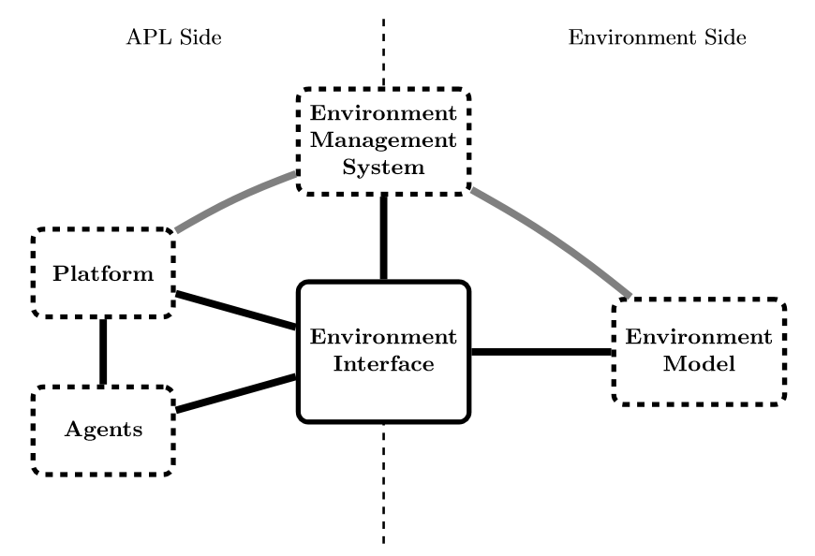
EIS Architecture Model

Slide 15
Agent / Entity Interaction
Agent
EI
Entity
Sense
Get Percepts
Get Percepts
Async Update of Percepts
Percepts
Percepts
Reason
Perform Action
Perform Action
?
Action / Perception
not directly linked
Result
Result
Act

Slide 16
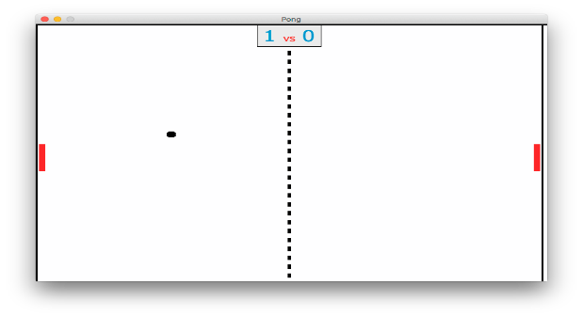
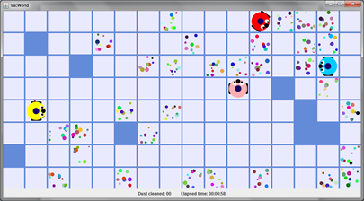
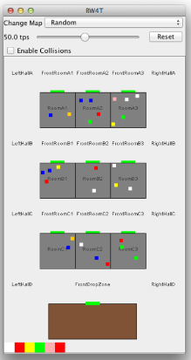
EISHub (https://github.com/eishub)
Online Repository of Environments:
Domestic Beer Serving Robot
Pong
TowerWorld
Vacuum Cleaner Agents
Block World for Teams…
Elevator Simulation
Massim (Multi-Agent Contest)
Unreal Tournament 3
Starcraft…
All available as maven projects…

Slide 17
EIS & Maven
Custom EIS repository:
<repositories>
<repository>
<id>eishub-mvn-repo</id>
<url>https://raw.github.com/eishub/mvn-repo/master</url>
</repository>
</repositories>
Environments as Maven Artifacts:
<dependencies>
<dependency>
<groupId>eishub</groupId>
<artifactId>tower</artifactId>
<version>1.3.0</version>
</dependency>
</dependencies>

Slide 18
Summary
EIS is an excellent framework for distributing pre-defined environments.
The key thing here is that the environment is fixed.
Key abstraction is entities.
These are basically agent bodies.
A one-2-many relationship applies
EIS can be used with multiple languages.
ASTRA, GOAL, Jason, Jadex, …
EIS is not compatible with > Java 8
The restriction is related to the way EIS loads the Environment Jar…

Slide 19
ASTRA and EIS

Slide 20
EIS & ASTRA (Maven)
<project xmlns="http://maven.apache.org/POM/4.0.0" xmlns:xsi="http://www.w3.org/2001/XMLSchema-instance"
xsi:schemaLocation="http://maven.apache.org/POM/4.0.0 http://maven.apache.org/xsd/maven-4.0.0.xsd">
<modelVersion>4.0.0</modelVersion>
<groupId>examples</groupId>
<artifactId>hello</artifactId>
<version>0.1.0</version>
<packaging>jar</packaging>
<parent>
<groupId>com.astralanguage</groupId>
<artifactId>astra-eis-base</artifactId>
<version>1.4.0</version>
</parent>
<properties>
<eis.artifactId>tower</eis.artifactId> <eis.version>1.3.0</eis.version>
</properties>
<build><defaultGoal>clean compile dependency:copy-dependencies astra:deploy</defaultGoal></build>
</project>

Slide 21
EIS & ASTRA (Maven)
<project xmlns="http://maven.apache.org/POM/4.0.0" xmlns:xsi="http://www.w3.org/2001/XMLSchema-instance"
xsi:schemaLocation="http://maven.apache.org/POM/4.0.0 http://maven.apache.org/xsd/maven-4.0.0.xsd">
<modelVersion>4.0.0</modelVersion>
<groupId>examples</groupId>
<artifactId>hello</artifactId>
<version>0.1.0</version>
<packaging>jar</packaging>
<parent>
<groupId>com.astralanguage</groupId>
<artifactId>astra-eis-base</artifactId>
<version>1.4.0</version>
</parent>
<properties>
<eis.artifactId>tower</eis.artifactId> <eis.version>1.3.0</eis.version>
</properties>
<build><defaultGoal>clean compile dependency:copy-dependencies astra:deploy</defaultGoal></build>
</project>
EIS only works with JAVA 1.8

Slide 22
EIS & ASTRA (Code)
agent Main {
module EIS ei;
module Console C;
rule +!main(list args) {
ei.launch("hw","dependency/tower-1.3.0.jar");
ei.init();
ei.start();
ei.link("gripper");
C.println("Press New Block until block d is created...");
wait(ei.block("d"));
C.println("You did it!");
ei.pickup("d");
wait(ei.holding("d"));
ei.putdown("d", "c");
wait(ei.on("d", "c"));
}
}
Source: https://gitlab.com/astra-language/examples/eis/astra-eis-tower/

Slide 23
EIS & ASTRA (Code)
agent Main {
module EIS ei;
module Console C;
rule +!main(list args) {
ei.launch("hw","dependency/tower-1.3.0.jar");
ei.init();
ei.start();
ei.link("gripper");
C.println("Press New Block until block d is created...");
wait(ei.block("d"));
C.println("You did it!");
ei.pickup("d");
wait(ei.holding("d"));
ei.putdown("d", "c");
wait(ei.on("d", "c"));
}
}
Special EIS module

Slide 24
EIS & ASTRA (Code)
agent Main {
module EIS ei;
module Console C;
rule +!main(list args) {
ei.launch("hw","dependency/tower-1.3.0.jar");
ei.init();
ei.start();
ei.link("gripper");
C.println("Press New Block until block d is created...");
wait(ei.block("d"));
C.println("You did it!");
ei.pickup("d");
wait(ei.holding("d"));
ei.putdown("d", "c");
wait(ei.on("d", "c"));
}
}
Initialization of the environment (done once)

Slide 25
EIS & ASTRA (Code)
agent Main {
module EIS ei;
module Console C;
rule +!main(list args) {
ei.launch("hw","dependency/tower-1.3.0.jar");
ei.init();
ei.start();
ei.link("gripper");
C.println("Press New Block until block d is created...");
wait(ei.block("d"));
C.println("You did it!");
ei.pickup("d");
wait(ei.holding("d"));
ei.putdown("d", "c");
wait(ei.on("d", "c"));
}
}
Registering the agent and linking to an entity.

Slide 26
EIS & ASTRA (Code)
agent Main {
module EIS ei;
module Console C;
rule +!main(list args) {
ei.launch("hw","dependency/tower-1.3.0.jar");
ei.init();
ei.start();
ei.link("gripper");
C.println("Press New Block until block d is created...");
wait(ei.block("d"));
C.println("You did it!");
ei.pickup("d");
wait(ei.holding("d"));
ei.putdown("d", "c");
wait(ei.on("d", "c"));
}
}
Querying the state of the environment

Slide 27
EIS & ASTRA (Code)
agent Main {
module EIS ei;
module Console C;
rule +!main(list args) {
ei.launch("hw","dependency/tower-1.3.0.jar");
ei.init();
ei.start();
ei.link("gripper");
C.println("Press New Block until block d is created...");
wait(ei.block("d"));
C.println("You did it!");
ei.pickup("d");
wait(ei.holding("d"));
ei.putdown("d", "c");
wait(ei.on("d", "c"));
}
}
Performing actions

Slide 28
EIS & ASTRA (Code)
agent Main {
module EIS ei;
module Console C;
rule +!main(list args) { ... }
rule +$ei.event(holding(string Y)) {
C.println("I picked up: " + Y);
}
rule +$ei.event(funct Y) {
C.println("Handling belief update: " + Y);
}
}
Environment Events

